Slide 1
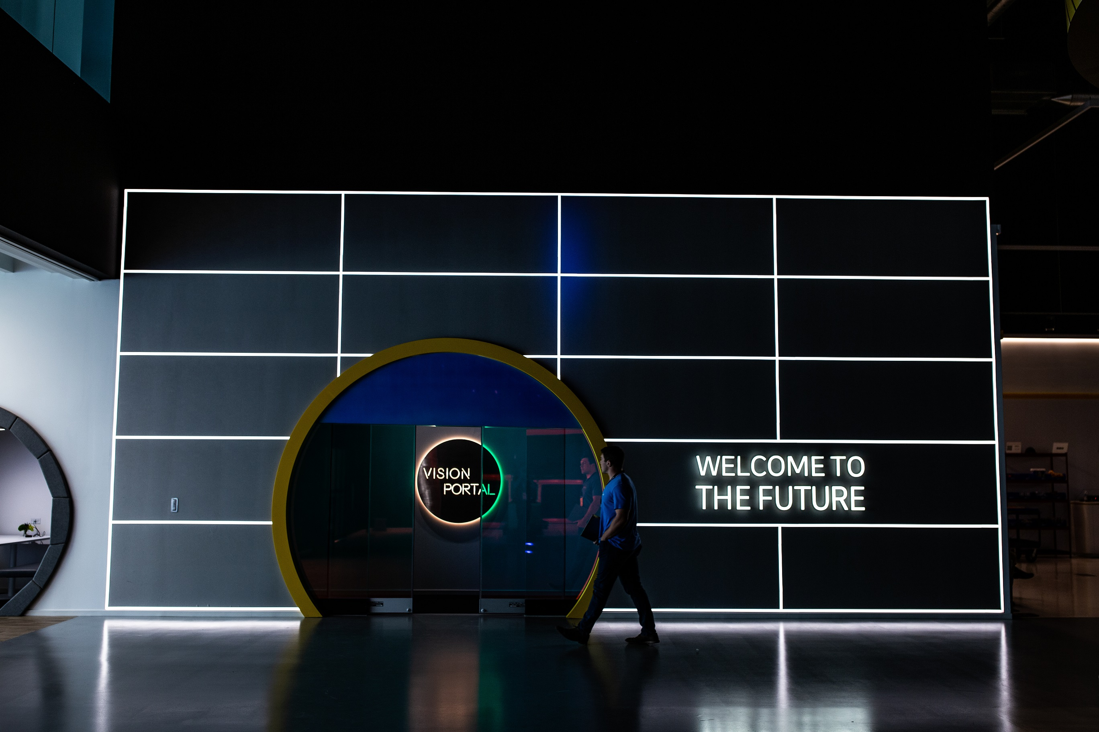
CLOUD & API’s
DHL LOGISTICS TREND RADAR CHANNEL DEEP Dive
Ben Gesing & Antony Cotterill
DHL Customer Solutions & Innovation

Slide 2

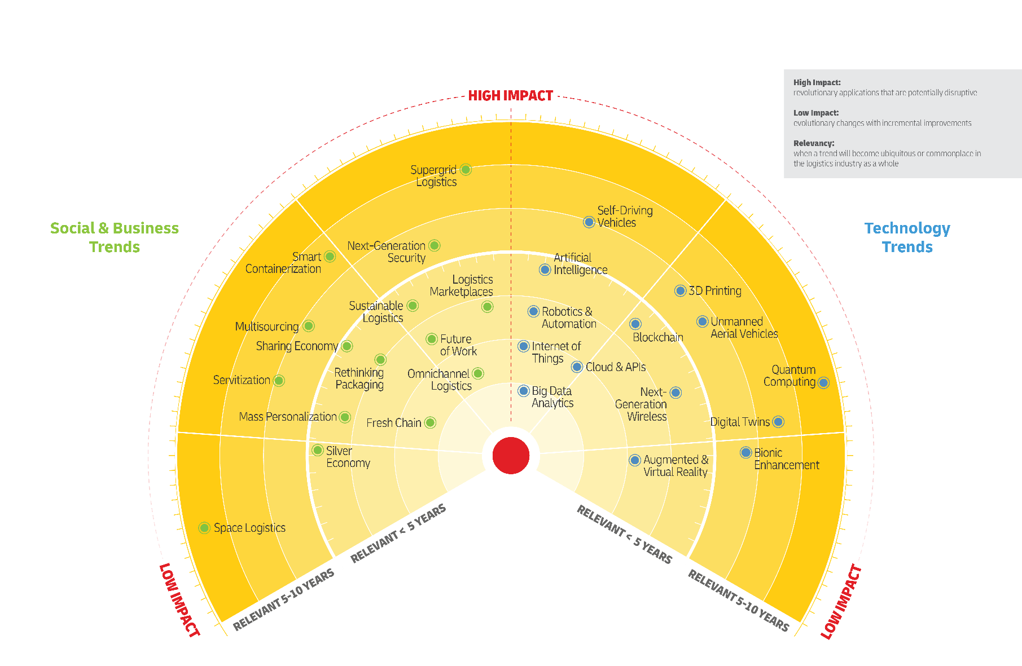

The DHL Logistics Trend RadarTM
SCAN TO DOWNLOAD THE LOGISTCS TREND RADAR

Slide 3
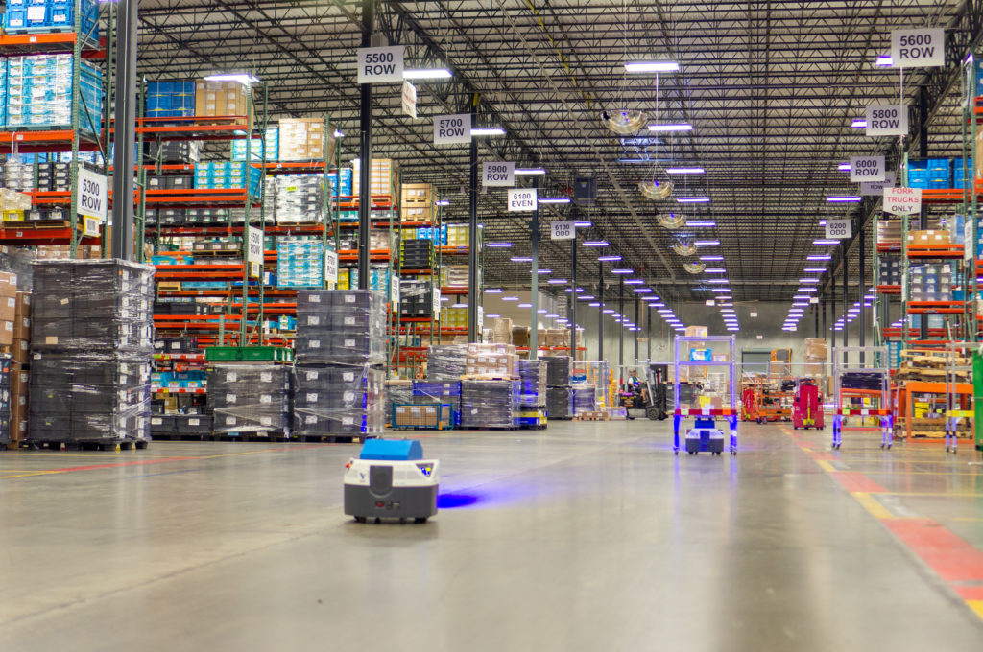
CLOUD & API‘S

Slide 4

UNDERSTANDING CLOUD & API’S
Cloud computing core to the digital transformation of the logistics industry at all levels
Costs | time to market | integration | continuous updates
Application Programming Interfaces (API’s) software protocols that allow applications to communicate and exchange information

Slide 5

WHY NOW?
16 Bn
11.2%
90%
2019 MARKET SIZE FOR SUPPLY CHAIN MANAGEMENT PLATFORMS
CAGR THROUGH 2027 FOR CLOUD-BASED SCM PLATFORMS
INVESTMENT INTO SCM SOLUTIONS TODAY ARE CLOUD BASED

Slide 6



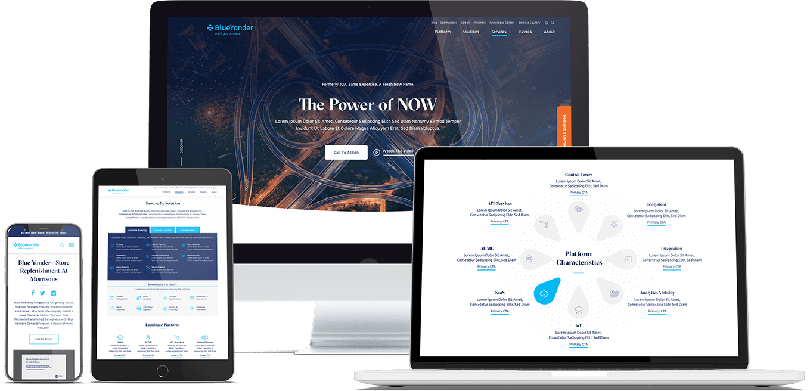
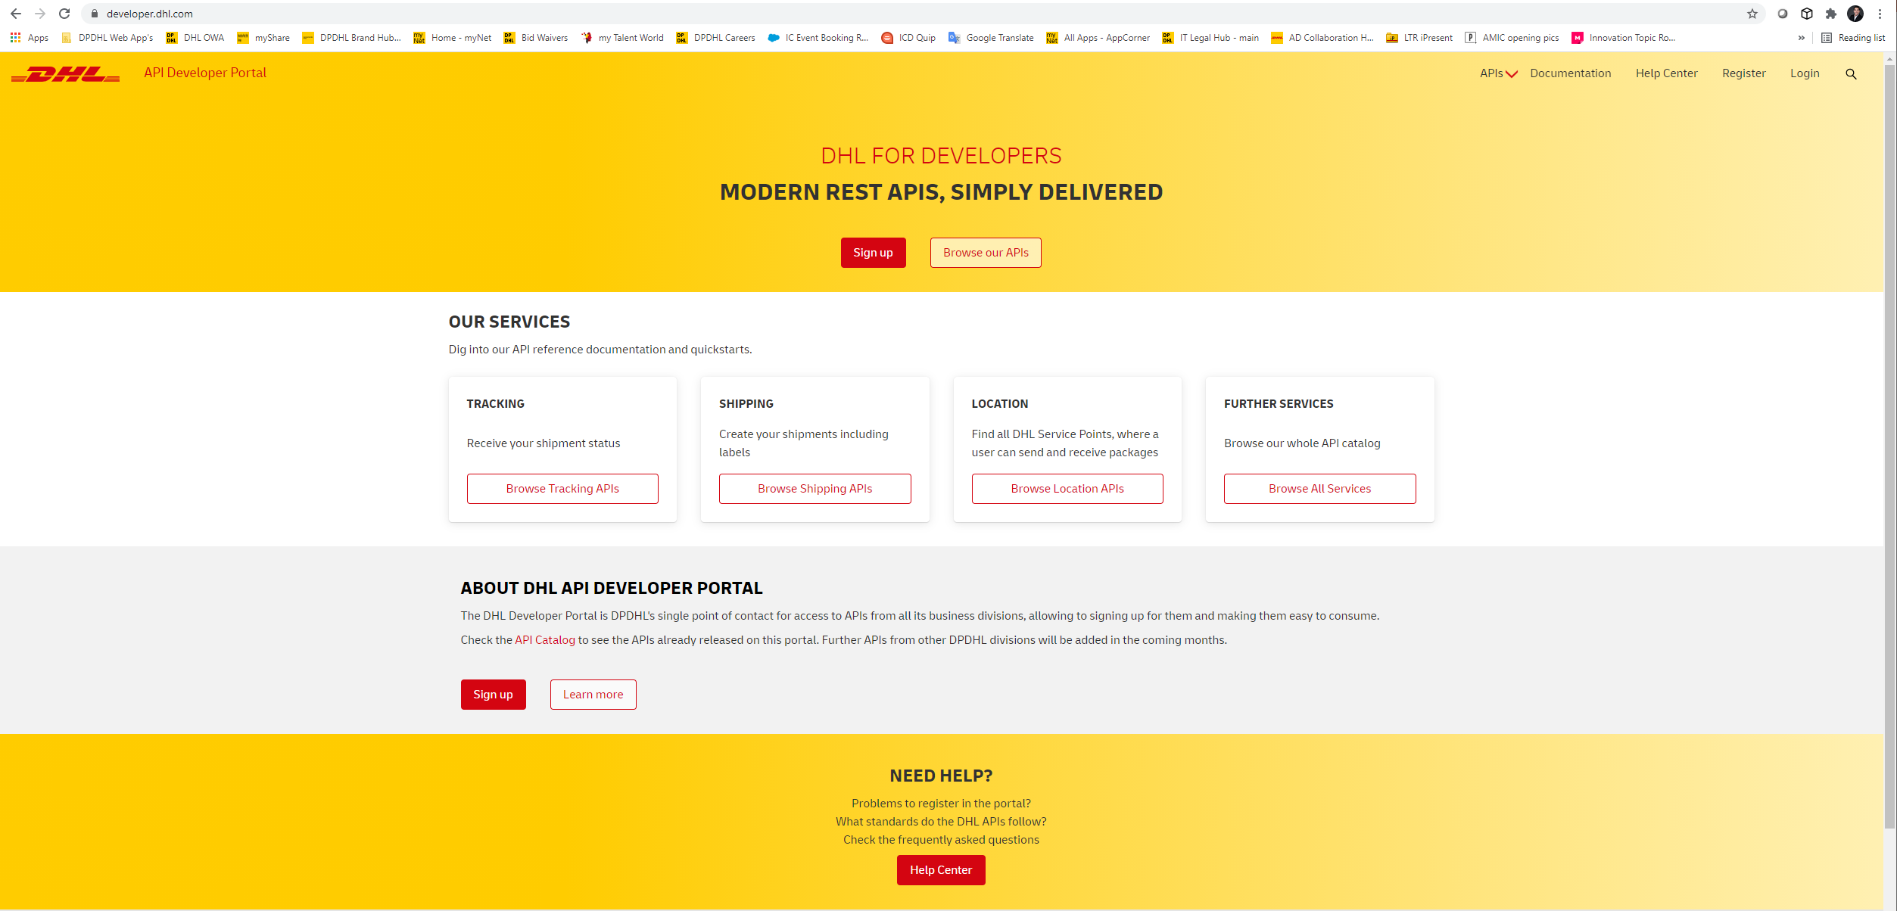
MAJOR OPPORTUNITIES FOR CLOUD & API’S IN LOGISTICS
FOCUS FOR TODAY
NEW BUSINESS MODELS & CUSTOMER EXPERIENCES
MODULAR CLOUD
LOGISTICS PLATFORMS
CLOUD-POWERED GLOBAL SUPPLY CHAINS
Seamlessly integrated logistics services in 3PV ecosystems of webshops, e-Commerce platforms & logistics marketplaces
On-demand logistics services (LaaS) available through standard interfaces and platforms to replace legacy EDI solutions
Optimal orchestration of goods, people, machinery and assets from central platforms. Faster time to market at lower cost

Slide 7


DHL Supply chain
Robotics hub (drh)
Antony Cotterill
VP, Global BY CoE

Slide 8
DHL SUPPLY CHAIN ROBOTICS HUB
What you’ll find
Pages
  Robotics Hub
What’s our vision – We’ll make our customer’s needs a reality
What’s Robotics Hub and what’s in it for you? - How it will support our business together
Robotics Hub Architecture
Our outlook for 2021 – What’s coming next?
Who’s involved? – Teams involved and how we prioritize
  3-10
Source: Accelerated Digitalization team

Slide 9
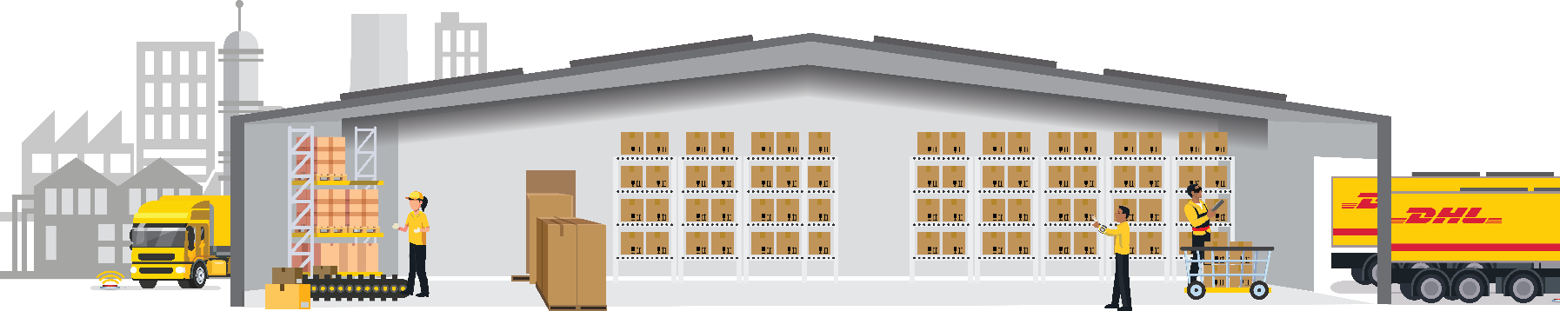

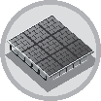



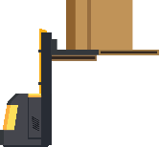




Our vision: To optimize supply chains end-to-end – using best in class robotic solutions and actionable data
AD Technology Category
Data collection point for DHL Supply Chain
Receiving/Put-away
Storage
Picking
Packing
Dispatch/Delivery
Intelligent Process Automation (RPA complemented by machine learning and adjacent technologies such as OCR and smart workflow tools)
Supporting Robots (e.g. cleaning robots, security robots, dimensioning)
SmartOperations (smart devices + standard software and apps for the shop floor)
Indoor Robotic Transport
Inventory Mgmt. Robots
Assisted Picking Robots
Wearable Devices
Goods-To-Person Robots
Robotic Arms
Wrapping Robots
Asset Tracking & Monitoring (truck, shipment unit)
Asset Tracking & Monitoring (Robot, colleague, pallet/shipment unit)
Algorithmic Optimization
of Tasks
How can I optimally prioritize and group tasks?
of Resources
How can I utilize my resources most efficiently?
of Inventory
How can I continuously optimize my inventory?
Other (tbd)
Source: AD Program Team; primary application of technologies across logistics process shown – not exhaustive; e.g. Indoor Robotic Transport also applicable for picking & support processes

Slide 10
The Robotics Hub is a collaborative platform that orchestrates Robotics and Automation by offering pre-connectivity between technologies and systems
The past
The present
Isolated Point to Point integrations - Every project is unique and customized
Re-usage of components only happens coincidentally
Individual integration complexity and cost are high
Customers value DHL for “getting it done”
Swift connection of all productive assets and resources to our systems – plug and play (platform)
Every project re-uses available components
Individual integration complexity and cost are low
Customers value DHL for clear advice on best fitting robotic and/or automation solution (cost, quality, time)
Locus
Site 1
Locus
6 River Systems
Site 2
6 River Systems
Strategic DHL
Site 1
Site 2
other
Rocla
Site 3
Rocla
Non-strategic DHL
Robotics hub
Site 3
Site 4
other
Geek+
Site 4
Geek+
Customer-Owned
Site 5
Site 6
other
ASRS
Site 5
ASRS
other
Other sites
other

Slide 11
What’s in it for you? Robotics Hub levers will support our functions to smoothly ensure our customers success
Function
Lever
Description
Opportunity Owner, Project Sponsor and Operations Owner
Risk and Cost reduction
Standardization
Customer Satisfaction
Faster implementation
Re-using standard components and deployment methodology in our start-ups will reduce the risks, costs of integration and duplication of efforts, making our customers successful
Solutions Design
Standardization
Available plug-and-play technologies portfolio
Robotic vendor innovation
With a pool of plug-and-play technologies available, it will be easier to bring optimal solutions for new and existing business, reducing the efforts and uncertainty of unknown robotic vendors to our customers
IT
Standardization
Increased range of supported robots
Robotics hub upgrades
With standardized architecture and a increasing portfolio of technologies, the efforts of integration will be reduced to a minimum. In addition, all updates and dashboard functionalities should be available to all robotic hub operations

Slide 12
Robotics Hub Architecture
As of February 2021
JDA Azure Cloud
DHL Azure Cloud
Area covered to date
Robotics Hub Architecture
User Interface/Dashboard
User Interface/Dashboard
Azure IoT Central
Robotics Hub
Data ingestion
Situation Handler
Event Hub/ Decision Handler
REST over HTTPS
API/Connector
Existing Method
DHL Supply Chain Operations
Assisted Picking robots
Indoor Robotic Transport robots
Other robots (to be added)
Warehouse Management System
Human resources (mobile)
Locus
6RS
other
Max-AGV
Rocla
other

Slide 13
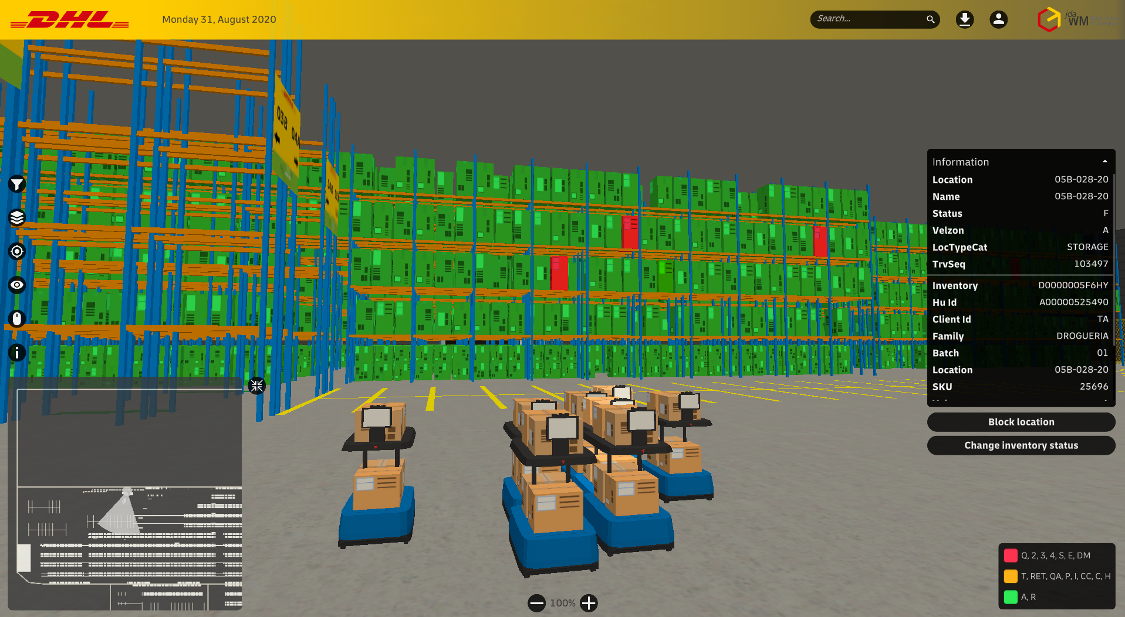
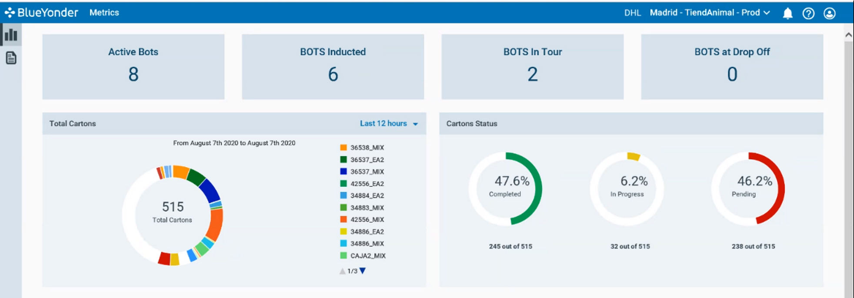
In addition to more efficient integration, the robotics hub also provides standard and continuous data feeds for reporting and potential 3D interaction opportunities
Mercury – Digital Twin Warehouse
Robotics Hub Dashboard

Slide 14
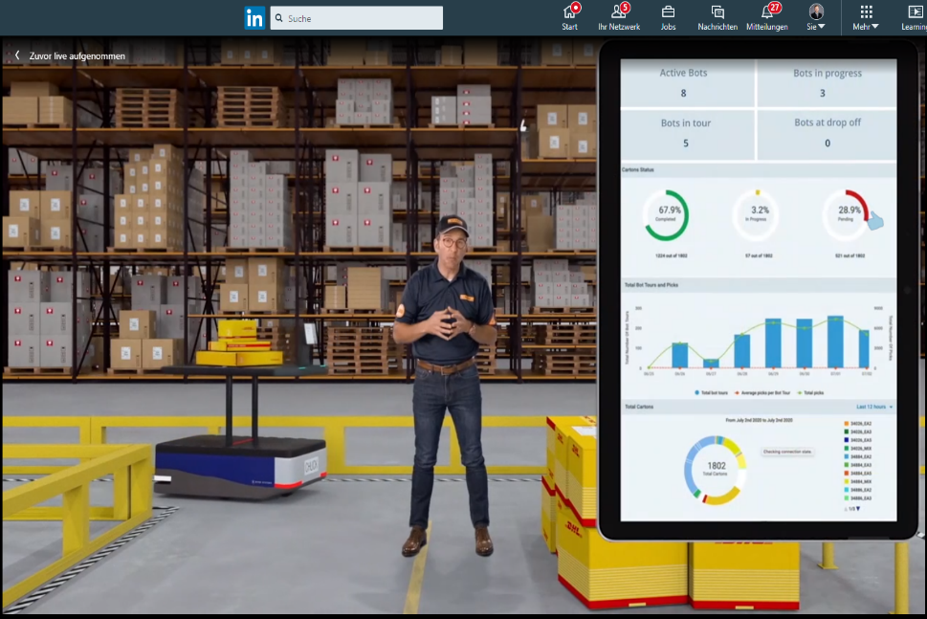
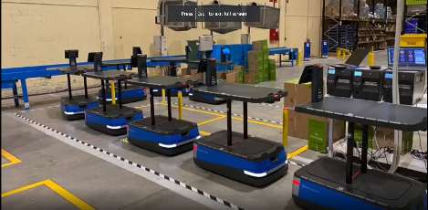
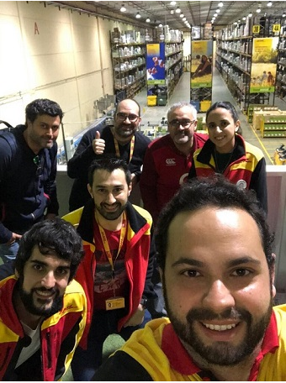
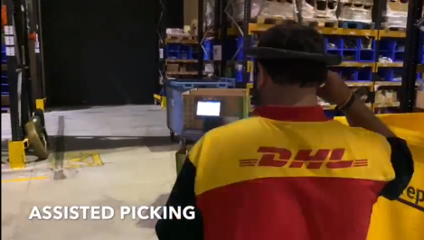
This journey already started: our Spanish team deployed eight 6 River Systems Chucks at Tiendanimal, Toledo using the DHL Robotics Hub
6 River Systems at Tiendanimal, Spain
Robotics Hub featured on Microsoft’s Inspire Conference
Click here to view the full video! (22:22)
Click here for the Press Release

Slide 15
Our prioritization method ensures to deliver the most impactful opportunities for our businesses
Guiding principles
Prioritization logic
Monthly process
We work as one team of business and IT experts
We aim for best available business and IT information to prioritize our robotics hub pipeline
We prioritize business impact over ease to integrate
We do not stop ongoing business integration projects, but look for paths to merge those onto the robotics hub efficiently
3) Investigate
2) Let’s make it happen
1) Sweet spot
Accelerated Digitalization Deployment Leads continuously flag high business need projects in AD Collaboration Hub
AD Product Development & Pipeline Manager consolidates information from AD Collaboration Hub and complements with Ease of technology information from Enterprise Architecture teams
Prioritization is confirmed in decision calls
High
4) Whenever capacity permits
3) Investigate
2) No regret move
Business need for technology/ vendor
Provided by AD RDLs in Collab Hub and pipeline review calls
6) Individual Analysis
5) Individual Analysis
4) Whenever capacity permits
Low
Customer-owned
Legacy DHL
Strategic DHL
Ease of technology/robotic-WMS-integration
Provided by Robotics Hub and Enterprise Architecture teams in pipeline review calls

Slide 16
Robotics Hub Opportunity Journey
This 5 steps user-oriented journey supports our teams to assess potential Robotics Hub opportunities and understand the process end-to-end
Potential Opportunity
Opportunity
Assessment
Planning & Approval
Deployment
Sustain
Is this technology a fit for the Robotics Hub?
High-level assessment of opportunities based on knock-out criteria from Robotics Hub
Checking the connectivity
Deep-dive assessment on WMS and vendor connectivities
Do we have an approval from our stakeholders?
Get necessary approvals to design the solution and implementation time-frames
Let’s go-live
After SIT/UAT are completed, our opportunity is live
How can we improve?
Build continuous improvement mindset and grow with feedbacks

